Slide 1
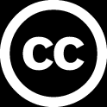
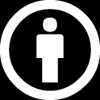
Machine Learning Adversarial Attacks on Neural Networks
Artificial Intelligence Training
Created by Andrew Ferlitsch Instructor October, 2017

Slide 2
What is Adversarial Attack on CNN
To Fool a pre-trained Image Recognition System into
misclassifying an image.
Example: A Cat is classified as a Toaster.
Example: A Stop Sign is classified as a Green Light.
Adversarial Examples are inputs into a trained image
classifier that an attacker has designed to intentionally
cause the trained model to make mistakes.
The adversarial examples appear to be unchanged
to the human eye, but fool the trained model.
Landmark Paper 2013 - Intriguing properties of neural networks, Cornell University

Slide 3
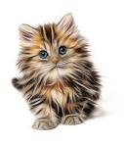
Overview
The output layer in the CNN is fooled to predict an incorrect classification.
Original Image
Hidden Layer
Input Layer
Output Layer
z₁
Softmax
Convolutional
Front-End
x₁
Predicts correct
class (cat) with
low confidence.
z₂
Modify
x₂
z₃
Predicts incorrect
class (toaster) with
high confidence.
x_{n}
z_{k}
Adversarial Image Still looks like original
To human eye.

Slide 4
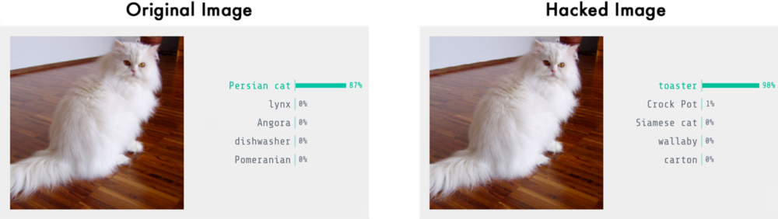
Popular Example from Blog
https://medium.com/@ageitgey/machine-learning-is-fun-part-8-how-to-intentionally-trick-neural-networks-b55da32b7196
This adversarial image was done on copy of Google’s Inception v3
The modified pixels are not detectable by the human eye.

Slide 5

Revisit How Model is Trained
Convolutional Neural Network
Convolutional
Front-End
Cat Classifier
Training Image
Cost (loss) function
C = $\frac{1}{2}\left(y −\text{ŷ}\right)2$
Softmax
Expected Label (cat)
Forward Feed the
Training Image
Predictor
Predicted Label
Backpropagation Adjustments to Weights
Repeat
Feeding
Image
NO
Meet Confidence Threshold?
YES
DONE

Slide 6
Modest Imperfections in Image
Small Imperfections in Image do not significantly impact classification.
Convolutional
Front-End
Image Input
Softmax
99% Cat
Imperfection
Convolutional
Front-End
Image Input
Softmax
97% Cat

Slide 7
Linear Separability in Neural Networks
Neural Networks are good are classifying non-linear data.
But they do it by segmenting up the analysis of the data into hundreds and thousands of hidden nodes that linearly separate the data.
Line (curve) that separates data
Outputs signal >0 and <=1 that is favorable to cat.
Input(s)
Outputs no signal.
Nodes in Hidden Layer
Outputs signal >0 and <=1 that is favorable to cat.
Input(s)
Outputs no signal.

Slide 8
Exploit the Linear Separability
Move data points (corresponding to a pixel) very near line of separation that
tiny change to value will move data point to other side of the line.
Target data point (e.g., pixel) close to separation line.
Output signal
Not favorable to cat.
Output signal
favorable to cat.
Target data point moved to other side of separation line.

Slide 9
Tweaking the Image
To Fool the classifier, we want to find pixels that
correspond to data points very near the line of separation
in the hidden nodes.
The nearer the point the smaller the change in value
is needed.
If the change in value is small enough, it will not be
detected by human eye.
Find enough points to tweak across the line.
Will change the classification.
The changes will not be noticeable to the human eye.

Slide 10
Use Backward Propagation on Image
During Training backward propagation is used to adjust
weights in nodes until classification is acceptable.
General method is to use gradient descent.
With gradient descent, on each pass we measure the direction.
Are we getting closer or further away, and adjust weights
positive or negative correspondingly.
With pre-trained model, the weights are already set.
Instead, we use backward propagation on the image.
We make small changes to pixel values and measure the
difference in cost function until we detect change and direction
in gradient descent.
Once we know the direction of change in gradient descent,
it can be exploited in predicting which pixels and corresponding
small changes to move from one classification to another.

Slide 11
Fooling a pre-trained model
Convolutional Neural Network
Convolutional
Front-End
Non-Cat Classifier (e.g., toaster)
Image being Hacked
Cost (loss) function
C = $\frac{1}{2}\left(y −\text{ŷ}\right)2$
Softmax
Hacked Label (toaster)
Forward Feed the
Hacked Image
Predictor
Predicted Label
Repeat
Feeding
Updated Hacked Image
Tweak the image based on change in gradient dirctio
NO
Meet Confidence Threshold?
Backpropagation of the changes to the Hacked image.
YES
DONE
Image is now labeled as a non-cat (toaster)

